Slide 1

Leo Scanlon HealthCIC LLC
AI:
IS IT?
And
What is it?
Security Challenges when models behave badly

Slide 2
In the beginning, there was AI
John McCarthy first coined the term artificial intelligence in 1956 when he convened the Dartmouth Summer Research Project on Artificial Intelligence, … many scientists concurred that human-level AI was just around the corner.
However, undelivered assertions caused a general disenchantment with the industry along the public and led to the AI winter, a period where funding and interest in the field subsided considerably.
Roger Schank and Marvin Minsky warned the business community that enthusiasm for AI had spiraled out of control in the 1980s and that disappointment would certainly follow. Three years later, the billion-dollar AI industry began to collapse.^{[2]}
IBM described Deep Blue as a supercomputer and explicitly stated that it did not use artificial intelligence, while it actually did.
During this period, a variety of other terms such as big data, predictive analytics and machine learning started gaining traction and popularity. In 2012, machine learning, deep learning and neural networks made great strides and started being utilized in a growing number of fields. Organizations suddenly started to use the terms machine learning and deep learning to advertise their products.
Deep learning started to perform tasks that were impossible to do with classic rule-based programming. Fields such as speech and face recognition, image classification and natural language processing, which were at early stages, suddenly took great leaps.
Hence, to the momentum, we are seeing a gearshift back to “AI.”

Slide 3
AI: What are they talking about?
The English Oxford Living Dictionary:
  “The theory and development of computer systems able to perform tasks normally requiring human intelligence, such as visual perception, speech recognition, decision-making, and translation between languages.”
Merriam-Webster:
  A branch of computer science dealing with the simulation of intelligent behavior in computers.
  The capability of a machine to imitate intelligent human behavior.
The Encyclopedia Britannica:
  “artificial intelligence (AI), the ability of a digital computer or computer-controlled robot to perform tasks commonly associated with intelligent beings.” Intelligent beings are those that can adapt to changing circumstances.

Slide 4
Sources:
Bernard Marr https://www.forbes.com/sites/bernardmarr/2018/02/14/the-key-definitions-of-artificial-intelligence-ai-that-explain-its-importance/#517c83454f5d
Roberto Iriondo https://medium.com/datadriveninvestor/differences-between-ai-and-machine-learning-and-why-it-matters-1255b182fc6
Zachary Lipton http://approximatelycorrect.com/2018/06/05/ai-ml-ai-swirling-nomenclature-slurried-thought/
Operational definitions:
  Build systems that think exactly like humans do (“strong AI”)
  Just get systems to work without figuring out how human reasoning works (“weak AI”)
  Use human reasoning as a model but not necessarily the end goal
Andrew Moore Dean of the School of Computer Science at Carnegie Mellon University,:
“Artificial intelligence is the science and engineering of making computers behave in ways that, until recently, we thought required human intelligence.”
Assistant Professor and Researcher at CMU, Zachary Lipton:,
  (the term AI) “is aspirational, a moving target based on those capabilities that humans possess but which machines do not.”

Slide 5
Machine learning is a branch of artificial intelligence
Professor and Former Chair of the Machine Learning Department at Carnegie Mellon University, Tom M. Mitchell:
“Machine learning is the study of computer algorithms that improve automatically through experience.”

Slide 6
Machine learning as the intersection of computer science and statistics:
Whereas Computer Science has focused primarily on how to manually program computers, Machine Learning focuses on the question of how to get computers to program themselves (from experience plus some initial structure).
Whereas Statistics has focused primarily on what conclusions can be inferred from data, Machine Learning incorporates additional questions about what computational architectures and algorithms can be used to most effectively capture, store, index, retrieve and merge these data, how multiple learning subtasks can be orchestrated in a larger system, and questions of computational tractability
A third field whose defining question is closely related to Machine Learning is the study of human and animal learning in Psychology, Neuroscience, and related fields.
--Tom Mitchell http://www.cs.cmu.edu/~tom/pubs/MachineLearning.pdf

Slide 7
Neural Networks and Deep Neural Networks
DNNs are complex machine learning models bearing certain similarity with the interconnected neurons in the human brain.
DNNs are capable of dealing with high-dimensional inputs (e.g. millions of pixels in high-resolution images), representing patterns in those inputs at various levels of abstraction, and relating those representations to high-level semantic concepts
Their rapid deployment in critical systems, like medical imaging, surveillance systems or security-sensitive applications, mandates that reliability and security are established a priori for deep learning models.
Similarly to any computer-based system, deep learning models can potentially be attacked using all the standard methods (such as denial of service or spoofing attacks), and their protection only depends on the security measures deployed around the system.
Additionally, DNNs have been shown to be sensitive to a threat specific to prediction models: adversarial examples. These are input samples which have deliberately been modified to produce a desired response by a model (often, misclassication or a specfic incorrect prediction which would benefit the attacker).
Source: Efficient Defenses Against Adversarial Attacks, Valentina Zantedeschi, Maria-Irina Nicolae, Ambrish Rawat
--IBM Research Ireland

Slide 8
Adversarial Networks and Generative Adversarial Networks (GANs)
A generative adversarial network (GAN) is a class of machine learning systems. Two neural networks contest with each other in a zero-sum game framework. This technique can generate photographs that look at least superficially authentic to human observers, having many realistic characteristics. It is a form of unsupervised learning.
GAN applications have increased rapidly.
GANs that produce photorealistic images can be used to visualize interior/industrial design, shoes, bags and clothing items or items for computer games' scenes. Such networks were reported to be used by Facebook.
GANs can model patterns of motion in video, reconstruct 3D models of objects from images and improve astronomical images.
GANs can be used to age face photographs to show how an individual's appearance might change with age.

Slide 9
Researchers have shown that GANs provide powerful password cracking capabilities, and can be used for secret communications: i.e., image integrity is relatively easy to compromise
PassGAN: Cracking Passwords With Generative Adversarial Networks
In this project, the researchers first used a GAN to test against password cracking tools John the Ripper and HashCat, and then to augment the guessing rules of HashCat.
The GAN was remarkably successful: It was trained on 9.9 million unique leaked passwords — 23.7 million including duplicates — which represented real human output. This is a rare example of a security application of GANs that does not involve images.
SSGAN: Applying GANs to Steganography
Secure Steganography Based on Generative Adversarial Networks Experimental results showed that, using the SSGAN architecture, the classification error of the steganalysis network increased, meaning that their generated stegonographic images were better for hiding information.
https://securityintelligence.com/generative-adversarial-networks-and-cybersecurity-part-2/

Slide 10
Types of Adversarial Machine Learning Attacks
There are two primary types of adversarial machine learning attacks:
Poisoning Attacks
This type of attack is more prevalent in online learning models — models that learn as new data comes in, as opposed to those that learn offline from already collected data. In this type of attack, the attacker provides input samples that shift the decision boundary in his or her favor.
Evasion Attacks
In this type of attack, an attacker causes the model to misclassify a sample. Consider a simple machine learning-based intrusion detection system (IDS)…(the) IDS decides if a given sample is an intrusion or normal traffic based on parameters A, B and C. Attacker discovers parameter, modifies it to make anomalous behavior appear normal.
Khan:
https://securityintelligence.com/how-can-companies-defend-against-adversarial-machine-learning-attacks-in-the-age-of-ai/

Slide 11
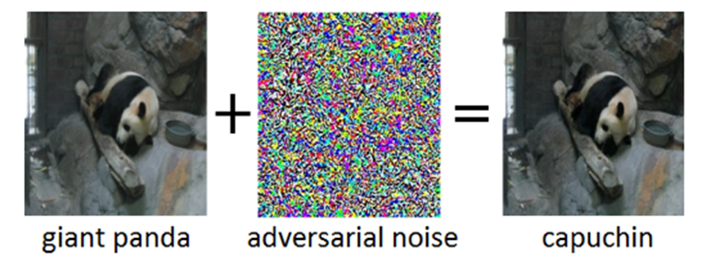
Adversarial attacks apply to DNNs which process images:
An intriguing property of DNNs is that, while they are normally highly accurate, they are vulnerable to so-called adversarial examples. Adversarial examples are inputs (say, images) which have deliberately been modified to produce a desired response by a DNN.
here the addition of a small amount of adversarial noise to the image of a giant panda leads the DNN to misclassify this image as a capuchin. Often, the target of adversarial examples is misclassification or a specific incorrect prediction which would benefit an attacker.

Slide 12
The approach for defending DNNs is three-fold:
•Measuring model robustness. Firstly, the robustness of a given DNN can be assessed. A straight-forward way for doing this is to record the loss of accuracy on adversarially altered inputs. Other approaches measure how much the internal representations and the output of a DNN vary when small changes are applied to its inputs.
•Model hardening. Secondly, a given DNN can be “hardened” to make it more robust against adversarial inputs. Common approaches are to preprocess the inputs of a DNN, to augment the training data with adversarial examples, or to change the DNN architecture to prevent adversarial signals from propagating through the internal representation layers.
•Runtime detection. Finally, runtime detection methods can be applied to flag any inputs that an adversary might have tempered with. Those methods typically try to exploit abnormal activations in the internal representation layers of a DNN caused by the adversarial inputs.
There are no standards, or control requirements (as yet) which would provide any level of assurance that any of these defense mechanisms are in place and working as intended

Slide 13
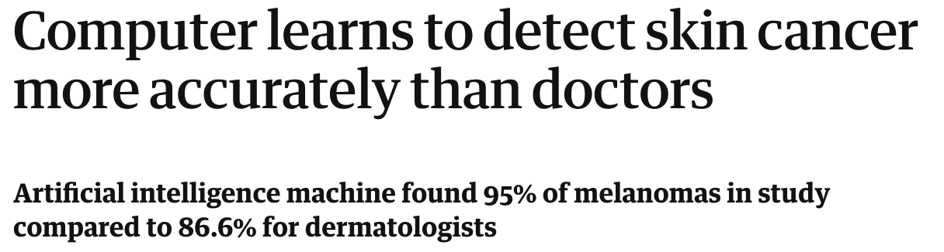
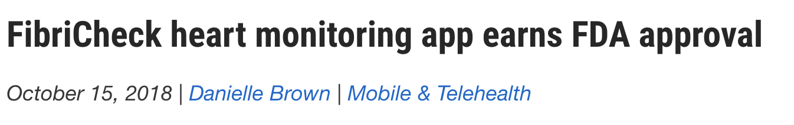
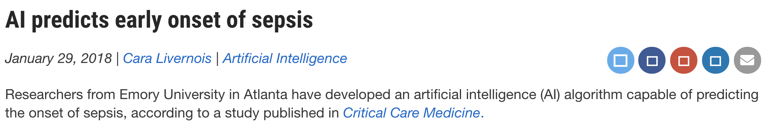


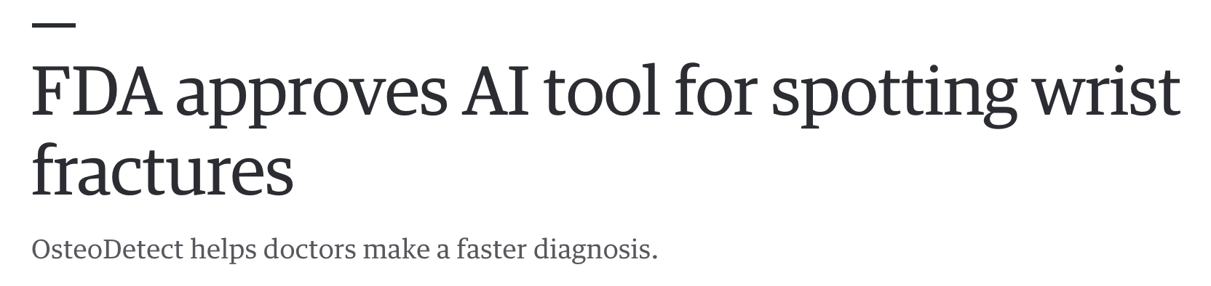
AI – Current State
Device-based
  Monitoring
  Detection and diagnosis
Image review
Voice assistants
  Nuance and Alexa
Broad EMR integration
  Sepsis detection
  Case summarization
“[Boston Children’s Hospital] also brought Alexa into … the ICU, [providing] nurses with basic intelligence on medication dosing, specific protocols, staff contact info and other relevant data points…”
Source: Aaron Heath
Notes:
Sources:
https://www.healthxl.com/blog/alexa-healthcare?utm_source=blog&utm_medium=email&utm_campaign=blog_wk_38
https://www.nuance.com/about-us/newsroom/press-releases/2018/Nuance-Introduces-AI-Powered-Cloud-Based-Clinical-Documentation-Excellence-Product-Suite-at-AHIMA-18.html
https://www.radiologybusiness.com/topics/artificial-intelligence/aidoc-fda-ai-artificial-intelligence-imaging
https://www.theguardian.com/society/2018/may/29/skin-cancer-computer-learns-to-detect-skin-cancer-more-accurately-than-a-doctor
https://www.engadget.com/2018/05/27/fda-approves-ai-wrist-fracture-detection/
https://www.clinical-innovation.com/topics/artificial-intelligence/ai-predicts-early-onset-sepsis
https://www.clinical-innovation.com/topics/mobile-telehealth/fibricheck-heart-monitoring-app-earns-fda-approval

Slide 14
AI is ubiquitous in healthcare space:
Management Of Chronic Diseases: assess patient medication needs, reading biosensors and automating the administration of medication and other treatments using connected mobile applications..
Medical Imaging: Companies are implementing the use of artificial intelligence to improve the clarity and accuracy of images while reducing exposure to harmful radiation
AI and The Internet Of Things: Companies are combining the technologies of AI and IOT to monitor patient diligence and adherence to treatment protocols..
AI In Robotic Surgery: Artificial intelligence is being used for all kinds of surgical procedures, from things as routine as a tonsillectomy to very involved brain surgeries.
Metronic: launched the MiniMed 670G system, an automated insulin pump designed for diabetics
GE Healthcare: medical imaging, speed and accuracy of CT scans.
Philips Healthcare: wearable biofeedback technology.
SkinVision : which uses computer vision to monitor suspicious skin lesions
AstraZeneca: announced a partnership with Alibaba subsidiary Ali Health to develop applications including AI-assisted screening and diagnostics in China.
Google DeepMind: advances in using AI to diagnose eye diseases.
Arterys.: Its cloud computing platform was approved by FDA for analyzing cardiac images,
It is now applying for FDA approval for AI in oncology.
MedyMatch:, is using deep learning to detect intracranial hemorrhage from CT scans.
The FDA recently gave it a “breakthrough device designation” to expedite the process of bringing the product to market.
The biggest bone of contention in a high-stakes industry like healthcare is who takes responsibility for misdiagnosis by AI software. The current wave of applications are all geared to assist radiologists and physicians, as opposed to serving as a final verdict on diagnosis

Slide 15
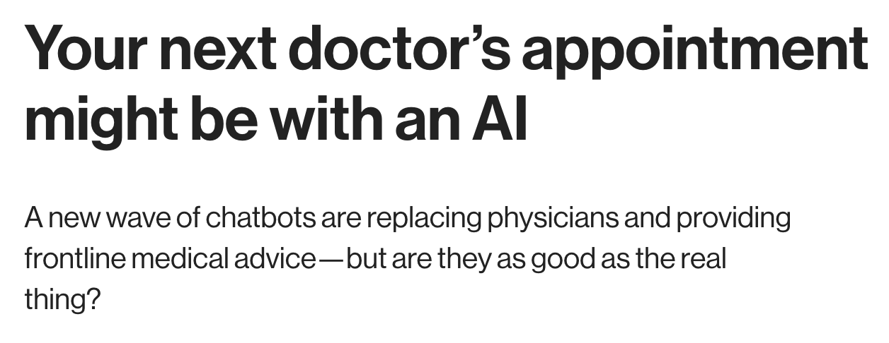

AI – Future State
From niche use cases to:
(More) Automated detection and diagnosis at scale
Automated/augmented clinical decision making
Automated robotic treatment
Real-time patient interaction with AI systems
AI-AI system interaction
Source: Aaron Heath
Notes:
https://www.technologyreview.com/s/612267/your-next-doctors-appointment-might-be-with-an-ai/
https://onlinelibrary.wiley.com/doi/full/10.1002/bjs.10860

Slide 16
Driving AI “to the edge”
The “home electric motor” -> the “home computer”->the edge device
“I think everything’s going to become a little bit smart, and I think very fast, we’re going to stop thinking of it as smart.I’m looking at my coffee pot [right now]. Your coffee pot is justgoing to know that it should make coffee for you; we’re not going to think of that as beingsmart anymore. It’s just going to be what coffee pots do. Just the way thermostats just keepthe temperature where you want it. At one point that was amazing.”--Marie des Jardins, Simmons University
Source: ©Knowingly, Inc.2019."AI at the Edge: A GigaOm Research Byte“
Train in the cloud, compute at the edge, that’s where the data is.
Notes:
Training is when a dataset is studied and the findings are built into an algorithm of some kind.
For example, a million cat photos need to be studied to learn how to identify future images of
cats. This process requires massive data and is compute intensive.
Inference is the application of a learned algorithm to a real-world problem. Training is about the
past, inference is about the present. Teaching the model to identify a cat is training while taking
a single photo and using that algorithm to discern whether it is a cat or not is inference. For an
individual photo, this is not terribly computationally rigorous, but it can become so if, for
instance, you wanted to count every photo on the web to see how many cats there are.

Slide 17
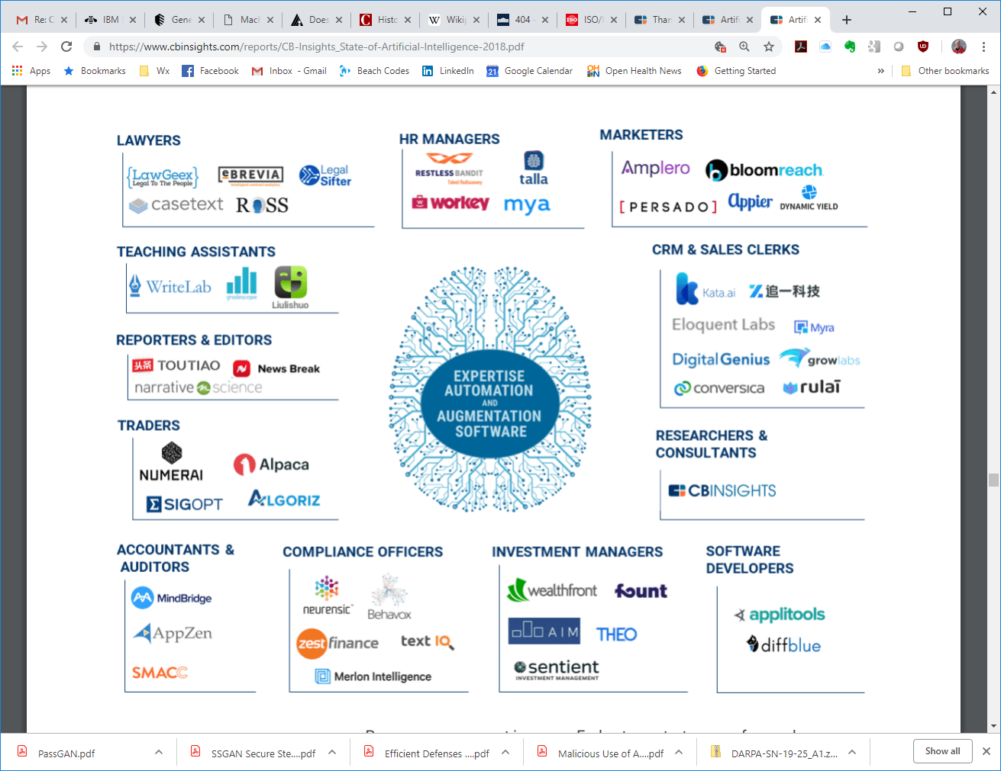
Security challenges presented by AI technology are not just a healthcare problem:
-- they are everybody’s problem

Slide 18
DIY AI is here:
You don’t need a PhD in computer science or mathematics to build your own AI.
Google launched an “AI for all ages” project called AIY (artificial intelligence yourself).
The first product was a do-it-yourself voice recognition kit for Raspberry Pi. .
Google also launched a vision kit with neural network software programs so users can make algorithms to identify dogs and cats, or to match emotion to facial expressions.
Amazon has launched DeepLens, a $249 deep learning-based video camera. Amazon is offering $7,500 for the winners of its first DeepLens hackathon, which involves building machine learning projects.

Slide 19

EXECUTIVE ORDERS
Executive Order on Maintaining American Leadership in Artificial Intelligence
(d) Within 180 days of the date of this order, the Secretary of Commerce, through the Director of the National Institute of Standards and Technology (NIST), shall issue a plan for Federal engagement in the development of technical standards and related tools in support of reliable, robust, and trustworthy systems that use AI technologies. NIST shall lead the development of this plan with participation from relevant agencies as the Secretary of Commerce shall determine.

Slide 20
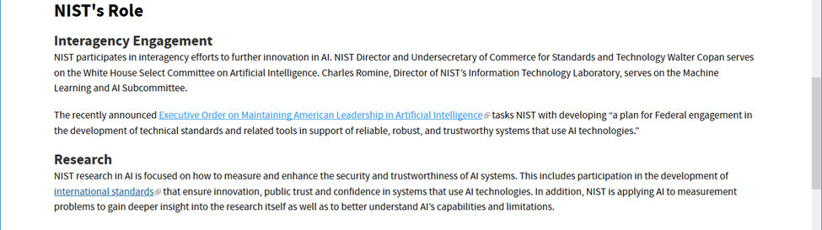



Slide 21
Source: http://www.petermorin.com/2017/12/nist-releases-new-cyber-security-framework-draft/
Source: Aaron Heath

Slide 22
Identify
Governance (ID.GV)
  Providers primarily play dual role – data providers and product consumers
  Where is your organization with regard to deploying these technologies?
  Sharing policies of ePHI/Limited Data Sets/de-identified data with AI vendors
  Regulatory impacts are complicated – 21st Century Cures vs Privacy laws; AI regs starting to crop up
Risk Assessments (ID.RA) and Risk Management Strategy (ID.RM)
  Incorporate uses into enterprise risk assessments
  What additional activities should we be conducting?
    Testing with historical data
    New fuzzing tools?
Source: Aaron Heath
This Photo by Unknown Author is licensed under CC BY-NC-ND

Slide 23
Identify
Supply Chain Risk Management (ID.SC)
  Trust criteria – FDA approval sufficient?
  Vendor reputation may not be established
  Standards and certifications - still valuable, but may need to be expanded
  Vendor data lifecycle policies and security risk analysis
  Monitoring partner vendors
Source: Aaron Heath
This Photo by Unknown Author is licensed under CC BY-NC-ND

Slide 24
Protect
Identity Management and Access Control (PR.AC)
  Systems requiring broad access to large data repositories – Sepsis, stroke detection
  Authenticating users of voice-activated assistants
Awareness and Training (PR.AT)
  AI fluency by cybersecurity personnel and sysadmins
Data Security (PR.DS)
  Understand data flows
  Data leakage – cloud vs local-only processing
  More robust anonymization techniques
  Massive and fast-moving data sets
  Defense in depth FTW
Source: Aaron Heath

Slide 25
Protect
Information Protection Processes and Procedures (PR.PP)
  Review incident response plans – backing out or disabling systems in response to cyber incidents
  IR plans may require clinician or vendor involvement
Maintenance (PR.MA)
  No longer just code-based patching
  Model Decay - validating updated algorithms
Protective Technology (PR.PT)
  Models as black boxes
  Standards and requirements for developers – explain yourselves
Source: Aaron Heath

Slide 26
Detect
Anomalies and Events (DE.AE) and Security Continuous Monitoring (DE.CM)
  How do we monitor for deviations from the norm?
  Network and system access baselining
a
Source: Aaron Heath

Slide 27
Respond
Communications (RS.CO)
  Information sharing – why we are here, right?
Source: Aaron Heath

Slide 28
Recover
Recovery Planning (RC.RP)
  Assess impact of incidents on integrity of models
  Do current back-up procedures provide adequate restore capability?
Communications (CR.CO)
  Explaining an AI-related cyber event to the public
  Maintaining the trust of our patients
  Lessons from recent accidents involving self-driving cars
Source: Aaron Heath

Slide 30
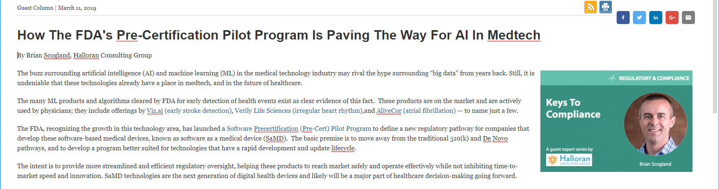

https://www.meddeviceonline.com/doc/how-the-fda-s-pre-certification-pilot-program-is-paving-the-way-for-ai-in-medtech-0001
https://www.fda.gov/MedicalDevices/DigitalHealth/DigitalHealthPreCertProgram/default.htm

Slide 31
FDA initiatives
https://www.mitre.org/news/press-releases/mitre-creates-playbook-on-medical-device-cybersecurity
https://www.fda.gov/MedicalDevices/DigitalHealth/ucm373213.htm
FDA Guidance page on SaMD policy
https://www.fda.gov/medicaldevices/digitalhealth/softwareasamedicaldevice/default.htm
IMDRF N12 Risk Categorization
http://www.imdrf.org/docs/imdrf/final/technical/imdrf-tech-140918-samd-framework-risk-categorization-141013.pdf
IMDRF N10 Key Definitions
http://www.imdrf.org/docs/imdrf/final/technical/imdrf-tech-131209-samd-key-definitions-140901.pdf
IMDRF N23 quality Management
http://www.imdrf.org/docs/imdrf/final/technical/imdrf-tech-151002-samd-qms.pdf
IMDRF N41 Clinical Evaluation
http://www.imdrf.org/docs/imdrf/final/technical/imdrf-tech-170921-samd-n41-clinical-evaluation_1.pdf
FDA Guidance for Industry; Clinical Evaluation criteria—IMDRF N41
https://www.fda.gov/downloads/MedicalDevices/DeviceRegulationandGuidance/GuidanceDocuments/ucm524904.pdf
FDA Medical Device Safety Action Plan
https://www.fda.gov/downloads/AboutFDA/CentersOffices/OfficeofMedicalProductsandTobacco/CDRH/CDRHReports/UCM604690.pdf

